Slide 1
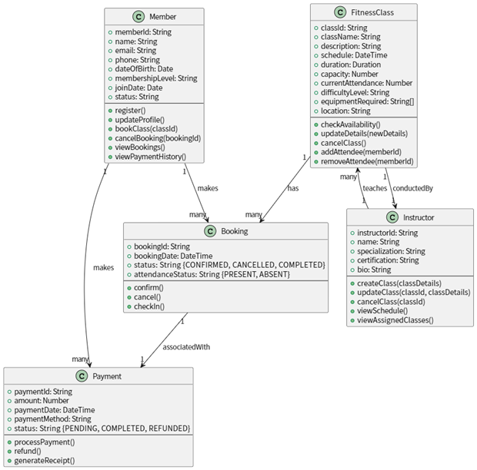
The Fitness Class Booking System is designed to help gym members and fitness instructors manage class bookings efficiently. Members can register, update their profiles, and book fitness classes based on availability. They can cancel bookings, view upcoming classes, and check payment history. Instructors can create, update, or cancel classes, view their teaching schedules, and see assigned classes.
Each fitness class includes details such as name, description, schedule, duration, capacity, difficulty level, required equipment, and location. Members can check class availability before booking, and the system tracks attendance through the `checkIn()` method. Bookings are confirmed upon payment, with receipts generated for transactions. Payments can be processed, refunded, or marked as completed.
The system coordinates between members and instructors, providing updates on class schedules, attendance (via `attendanceStatus`), and payment statuses. Members make bookings, which are associated with payments, while instructors teach fitness classes.
方法已经体现的
直接给出方法的
未体现的
类：无
枚举：无
属性：类中的属性应该被定义为枚举类型、EquipmentRequired应该用EquipmentType[]
方法：类中的方法定义重复
关系：无
Fitness class booking system

Slide 2
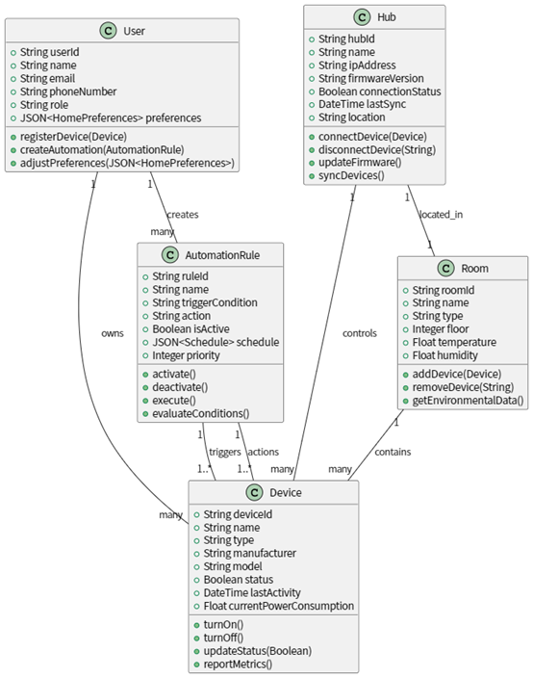
The Smart Home Automation System enables users to control and automate their home devices efficiently. Users can register with personal details, manage smart devices, create automation rules, and adjust home preferences through customizable profiles that include their role (e.g., admin, guest).
Users can add various smart devices (e.g., lights, thermostats, cameras) to the system, which are categorized by type, manufacturer, and model. Devices can be turned on/off, report power consumption metrics, and update their status. These devices are organized into rooms, where each room maintains environmental data (temperature, humidity) and can contain multiple devices.
Automation rules allow users to define conditions (based on time, device states, or other triggers) that execute actions on devices (e.g., turn on lights at sunset). Rules can be scheduled, prioritized, and activated/deactivated as needed. Each rule can trigger actions on one or more devices.
A central hub manages device connectivity, firmware updates, and synchronization, ensuring seamless communication. Each hub is located in one specific room and can control multiple devices. Users can monitor device activity, energy usage, and automation performance through the system, providing a smart and responsive home environment.
The system supports multi-room configurations with environmental monitoring and role-based access control for different users.
方法已经体现的
直接给出方法的
未体现的
类：无
枚举：无
属性：给出了<homePreference>、<Schedule>的Json，并未给出具体的结构
方法：开、关未关联status；execute()未包含校验条件
关系：many应该替换成*
Smart home automation system

Slide 3
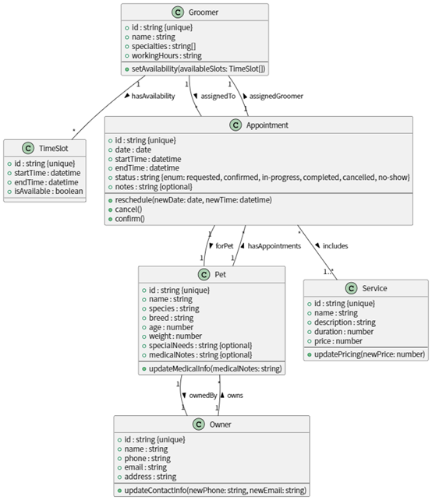
**Pet Grooming Scheduling System**
The Pet Grooming Scheduling System facilitates efficient management of pet grooming appointments between pet owners, groomers, and grooming businesses.
**For Pet Owners:**
- Register pets with details including: name, species, breed, age, optional weight, and optional special needs/medical notes
- Schedule appointments by selecting from available time slots
- Choose from available grooming services (which may include multiple services per appointment)
- View and manage upcoming appointments
**For Groomers:**
- Maintain profiles with specialties and working hours
- Manage availability through time slots (marked as available or booked)
- View, confirm, reschedule, or cancel appointments
- Track appointment status (requested, confirmed, in-progress, completed, cancelled, or no-show)
- Access pet medical/special needs information for upcoming appointments
方法已经体现的
直接给出方法的
未体现的
类：Groomer和Owner属性相似，前者偏预约时段、后者偏与宠物的关系，区别不太明显，是否可通过继承抽象类进行构建
枚举：无
属性：无
操作：Appointment 的 reschedule ，未更新 TimeSlot 的 isAvailable
关系：无
未按纯文本格式给出
Pet grooming scheduling system

Slide 4
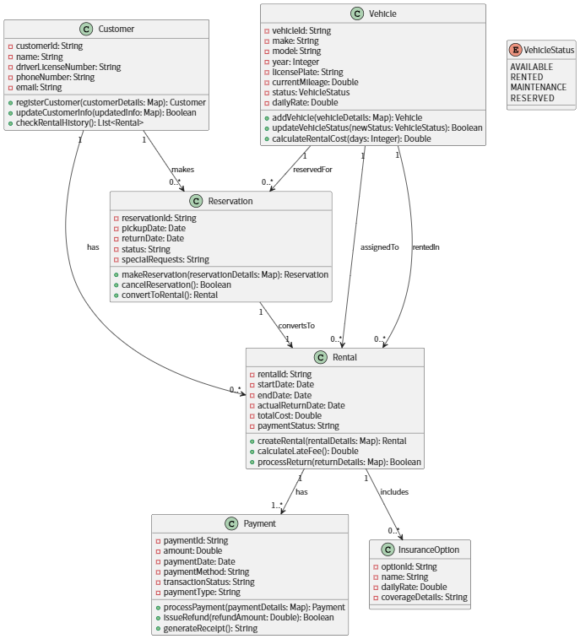
The CarRentalSystem application helps customers rent vehicles efficiently while enabling rental companies to manage their fleet and reservations.
Customers can register by providing their name, driver's license number, phone number, and email. Once registered, they can browse available vehicles, make reservations, and manage their rental history. A vehicle's details include its make, model, year, license plate, currentMileage, and status (available, rented, in maintenance, or reserved). Customers can reserve a vehicle for specific pickup and return dates, with the option to include special requests.
Reservations can be converted into rentals, where the customer picks up the vehicle and agrees to the rental terms. The system calculates the total cost based on the daily rate and rental duration. If a vehicle is returned late, a late fee is applied. Customers can also select one or more optional insurance coverage options, which add to the total cost.
Payments are processed upon rental confirmation, with support for different payment methods (e.g., credit card, cash). Refunds can be issued if applicable. The system tracks payment status and generates receipts.
Rental companies can manage their fleet by adding new vehicles, updating their status (e.g., marking a vehicle as under maintenance), and monitoring reservations and active rentals. The system ensures efficient tracking of vehicle availability and customer transactions.
已经体现的
直接给出方法的
未体现的
类：无
枚举：无
属性：无
操作：Reservation 的 convertToRental ，未联动 Vehicle 状态变更，缺少参数
关系：无
Car rental system

Slide 5
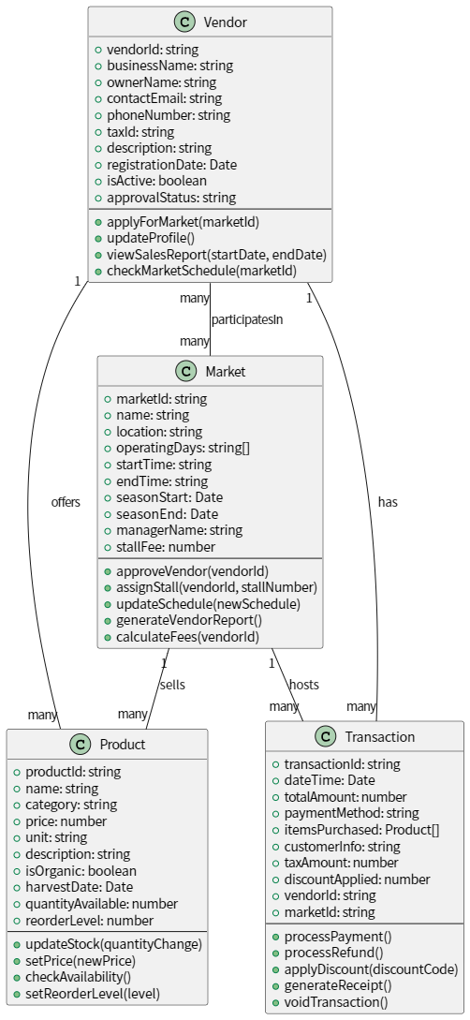
The system facilitates vendors in managing their participation in farmers markets. Vendors register with essential details including business name, owner name, contact information, tax ID, business description, registration date, and active/approval status. Vendors can apply for market participation, update their profiles, view sales reports, and check market schedules.
Markets are managed with comprehensive details including location, operating days/hours, seasonal dates, stall fees, and manager information. Administrators can approve vendors, assign stalls, update schedules, generate reports, and calculate fees.
Vendors offer multiple products with detailed information such as name, category, price, unit, description, organic status, harvest date, available quantity, and reorder levels. Products can be updated for stock levels, pricing, availability checks, and reorder thresholds.
Transactions record complete sales data including date/time, total amount, payment method, purchased items (with product details), customer information, taxes, discounts, and associated vendor/market. The system supports payment processing, refunds, discounts, receipt generation, and transaction voiding.
已经体现的
直接给出方法的
未体现的
类：无
枚举：无
属性：Vendor 的 businessName ownerName ，Market 的 managerName未说明“名称唯一性约束”
方法：Vendor的applyForMarket、Market的 approveVendor ，本质是 “入驻流程” 两端操作，却分散在两个类。应抽象成流程类
Farmers market vendor management system

Slide 6
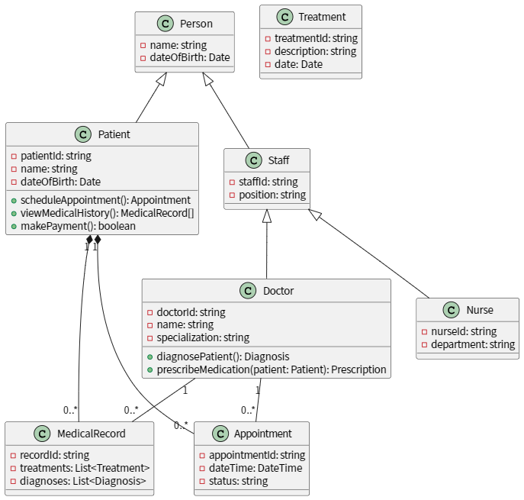
The Hospital Management System is designed to streamline patient care and administrative tasks within a healthcare facility. Patients can schedule appointments through the `scheduleAppointment()` method, view their medical history via `viewMedicalHistory()`, and make payments for services using `makePayment()`. Each patient has a unique identifier (patientId), name, and date of birth, inheriting these personal details from the **Person** class.
Doctors, who are specialized staff members with a specialization attribute, diagnose patients through `diagnosePatient()` and prescribe medications via `prescribeMedication()`. They are directly associated with both appointments and medical records. Nurses, also part of the staff, have a department attribute and assist in patient care within their specific departments.
All staff members (including doctors and nurses) inherit basic personal details (name, date of birth) from **Person** through the **Staff** class. Patients also inherit from **Person** but are not considered staff.
Appointments are scheduled with a date/time and status (e.g., confirmed, canceled). Medical records store detailed treatment histories, including procedures and diagnoses, and are directly associated with both patients and doctors.
The system ensures efficient coordination between patients, doctors, and nurses while maintaining accurate medical and administrative records through these defined relationships and functionalities.
已经体现的
直接给出方法的
未体现的
Hospital management system
类：无
枚举：无
属性：Patient重复定义父类的属性、doctorID和NurseID冗余
方法：Patient中的makePayment()未体现支付关联对象
关系：无

Slide 7
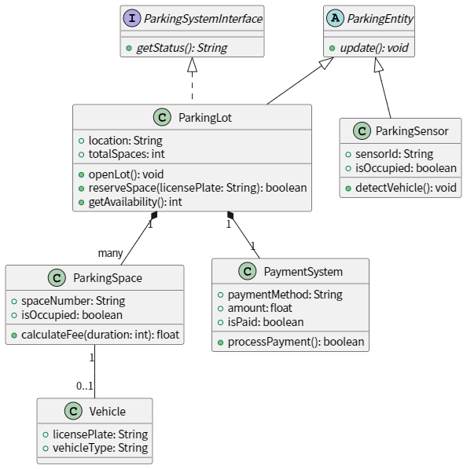
The smart parking system helps drivers efficiently find and reserve available parking spaces in a parking lot. The system tracks parking space occupancy in real-time using sensors, calculates parking fees, and processes payments.
A parking lot has a specific location and a fixed number of total spaces. It can be opened for operation (`openLot()`), and drivers can reserve spaces by providing their vehicle's license plate (`reserveSpace()`). The system provides real-time availability updates (`getAvailability()`) and continuously updates its status (`update()`).
Each parking space is identified by a unique number and has an occupancy status. Parking sensors detect vehicle presence (`detectVehicle()`) and update occupancy status automatically. The system can calculate parking fees (`calculateFee()`) based on duration when requested.
The `PaymentSystem` (associated with the `ParkingLot`) supports multiple payment methods, processes transactions (`processPayment()`), and confirms payment completion. A vehicle is identified by its license plate and type (e.g., car, motorcycle).
The system ensures efficient parking management by providing real-time status updates, fee calculation, and seamless payment processing. Drivers can reserve spaces, check availability, and pay for parking without manual intervention.
Smart parking system
类：ParkingEntity是抽象类，但ParkingLot和ParkingSensor仅用update()关联，关系不清晰
枚举：vehicleType和ParkingLotStatus应为枚举类
属性：无
关系：many不准确
方法：无

Slide 8
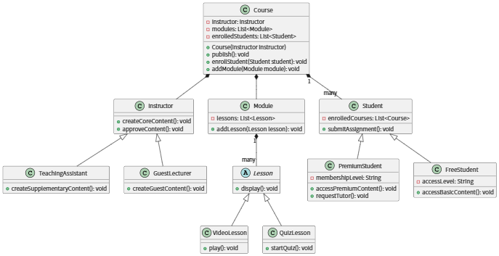
The online learning platform facilitates course creation, management, and student engagement for educational institutions or individual instructors.
Instructors (who may be regular instructors, teaching assistants, or guest lecturers) design and oversee courses, which consist of modular content such as video lessons and quizzes. Instructors can create core content, approve materials, and manage enrollments. Teaching assistants can create supplementary content while guest lecturers provide specialized guest content.
Courses are composed of modules, each containing multiple lessons (including video lessons and quiz lessons). Students enroll in courses and interact with the learning materials based on their access level.
The platform supports two types of students:
- Free students who can access basic content and submit assignments
- Premium students who receive additional benefits including exclusive materials, tutor support through the requestTutor() functionality, and access to premium content
The platform's structured approach through organized modules, lessons, and differentiated user roles enhances the educational experience while maintaining clear relationships between all entities as defined in the domain model.
Online learning platform
类：无
枚举：无
属性：Course 的 modules 、Module 的 lessons ，未说明 “课程 - 模块 - 课时” 的层级约束（如模块必须属于课程，课时必须归属模块 ），属性集合的 “父子关系规则” 缺失，业务结构易乱。
方法： Instructor、TeachingAssistant、GuestLecture都有CreateContent方法其余未进行区分

Slide 9
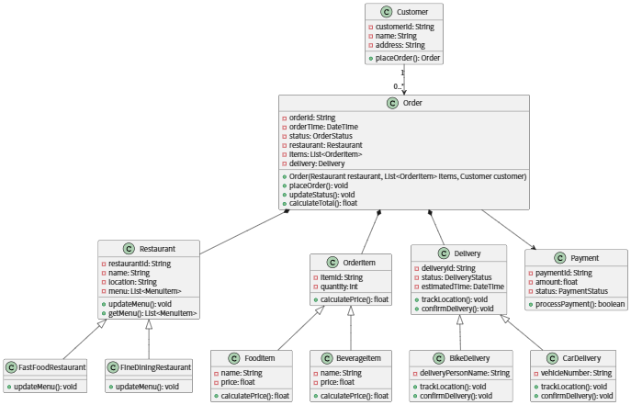
The food delivery platform enables customers to place orders from various restaurants, including fast-food and fine-dining establishments. Customers provide their name and address (as per the `Customer` class) and can place multiple orders over time. Each order includes one or more food or beverage items (represented by `FoodItem` and `BeverageItem` classes) from a restaurant's menu, along with delivery details.
Restaurants (modeled as `Restaurant`, `FastFoodRestaurant`, and `FineDiningRestaurant` classes) manage their menus, which consist of food and beverage items with associated prices. When a customer places an order, the system calculates the total cost (using the `calculateTotal()` method in `Order` and `calculatePrice()` methods in `OrderItem`), processes the payment (via the `Payment` class), and assigns a delivery method (bike or car, represented by `BikeDelivery` and `CarDelivery` subclasses). The delivery status (`DeliveryStatus`), estimated arrival time, and real-time tracking (via `trackLocation()`) are available to both customers and restaurants.
Customers can track their orders (using `OrderStatus` and `DeliveryStatus`), while restaurants receive order details and update their menus (via `updateMenu()`) as needed. The system supports different restaurant types (`FastFoodRestaurant` and `FineDiningRestaurant`) and delivery methods (`BikeDelivery` and `CarDelivery`), ensuring flexibility in service offerings.
Food delivery platform
类：无
枚举：无
属性：无
方法：无
关系：无

Slide 10
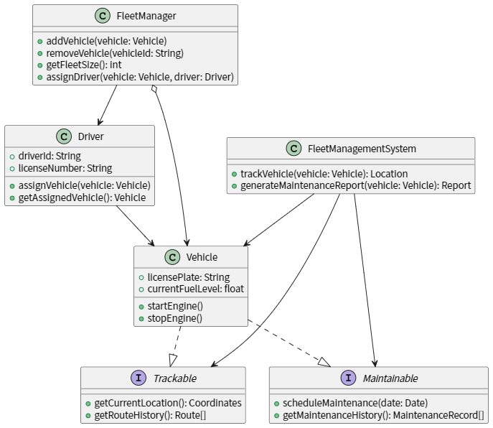
The Fleet Management System oversees and optimizes vehicle fleet operations. It enables fleet managers to track vehicles, schedule maintenance, and manage driver assignments.
**Vehicles** are equipped with tracking and maintenance capabilities. Each vehicle has a `licensePlate` and `currentFuelLevel`, along with methods to `startEngine()` and `stopEngine()`. Through the `Trackable` interface, vehicles provide real-time location (`getCurrentLocation()`) and `getRouteHistory()`. The `Maintainable` interface allows scheduling maintenance (`scheduleMaintenance(date: Date)`) and retrieving `getMaintenanceHistory()`.
**Fleet Managers** can:
- Add/remove vehicles using `addVehicle(vehicle: Vehicle)` and `removeVehicle(vehicleId: String)`.
- Check fleet size via `getFleetSize(): int`.
- Assign drivers to vehicles with `assignDriver(vehicle: Vehicle, driver: Driver)`.
**Drivers** are identified by a unique `driverId` and `licenseNumber`. They can be assigned to a vehicle (`assignVehicle(vehicle: Vehicle)`) and retrieve their assigned vehicle (`getAssignedVehicle(): Vehicle`).
**FleetManagementSystem** provides core functionalities:
- Track vehicles via `trackVehicle(vehicle: Vehicle): Location`.
- Generate detailed maintenance reports using `generateMaintenanceReport(vehicle: Vehicle): Report`.
This integration of tracking, maintenance, and driver management ensures efficient operations, reduces downtime, and improves fleet performance.
Fleet management system
类：FleetMsystem和FleetM职责边界模糊
枚举：无
属性：无
方法：assignDriver和Vehicle两个方法缺少返回值
关系：未标明关联的多重性
未按纯文本格式给出

